Slide 1

summAId Clinical Intelligence Platform

Slide 2
Team Size, Background, Strength /Capability
TEAM MEMBERS
Product Team Tharun M: Product Lead Nitish Kumar: Co- Lead Y Vikas: Product Marketer Chandravesh: Product Designer Development Team Vishwas K: Development Lead Nachiketha: Backend Developer Vignesh B G: Frontend Developer
Test Team Yashwanth Gowda: Test Lead Vinod Kumar: Manual Tester Venkat B: Performance Tester

Slide 3

Problem Statement
→Clinicians (Doctors, MAs) face significant information overload from fragmented patient data scattered across lengthy EMR reports (Radiology, Pathology, Labs, Notes).
→Manually reviewing and synthesizing this data before each patient visit is time-consuming, increases cognitive load, contributes to burnout, and carries a risk of missing critical details, potentially impacting patient safety. →Fragmented Longitudinal Data: Doctors struggle to track evolution (e.g., tumor growth or hearing loss trends) across years of PDF reports.
→One Size Doesn't Fit All: A generic AI summary fails because Oncologists need tumor timelines, while Audiologists need frequency charts

Slide 4

Product/ Solution - Innovation
What it is & How it Works
>Secure AI Assistant: Runs on-premise within the hospital's firewall for maximum data privacy.
>Core + Modules Architecture": A universal secure engine that plugs in specialty-specific brains.
>Intelligent Context Retrieval: Uses AI to find the most relevant history for upcoming visits.
>Concise Pre-Visit Summaries: A local LLM synthesizes multi-modal data into actionable, easy-to-read summaries.
>"Glass Box" Verifiability: Every statement links directly back to its source in the original report, building clinical trust.

Slide 5

Unique Selling Point
Why it's Unique
>Fortress Architecture": 100% On-Premise (No Cloud APIs). Privacy by Design.
>True Multi-Modal Synthesis: Goes beyond basic summarization to connect findings across different reports (Radiology, Pathology, Labs, Notes) and time points.
>Verifiable Citations: Our "Glass Box" approach provides direct links to source documents, guaranteeing accuracy and fostering clinician trust.
>Beyond Text": SummAID doesn't just summarize; it visualizes.

Slide 6
TECH STACK
Backend: Python with FastAPI .
Database: PostgreSQL (Robust relational DB).
Extensions: pgcrypto and pgvector
AI Engine: Ollama (Ensures on-premise processing).
AI Orchestration: LangChain
Frontend: React with Vite
Deployment: Docker containers
PDF Parsing: PyMuPDF

Slide 7
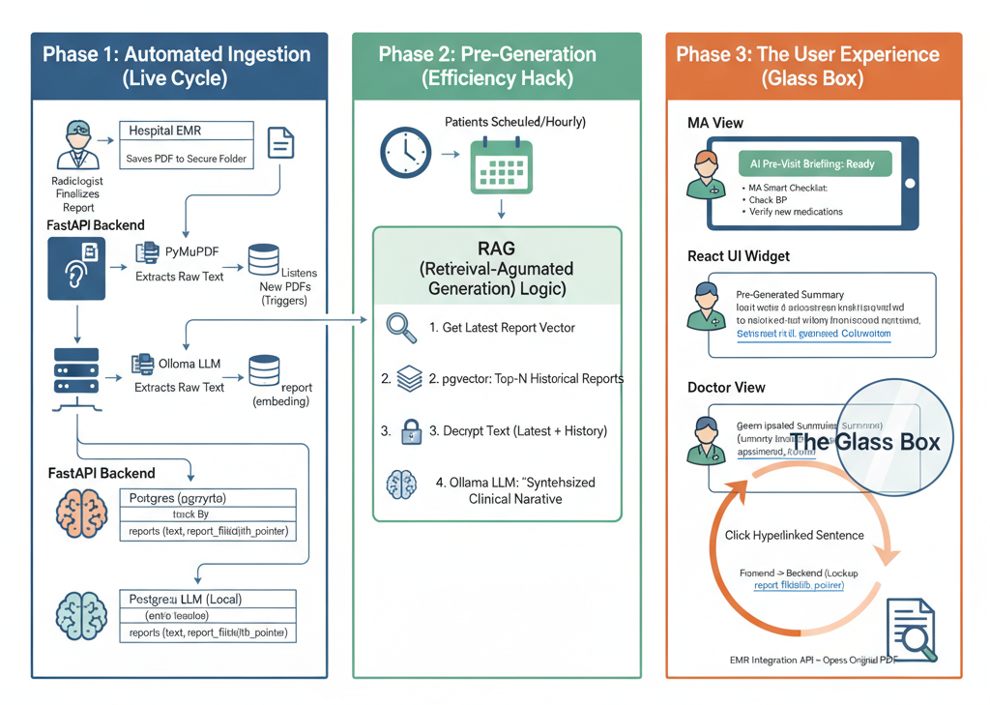
WORKFLOW

Slide 8
Market Landscape - Market Potential, Competitors
Market Opportunity
>Vast & Growing: Global Healthcare AI market is projected to reach several lakhs by 2027 , with significant investment in clinical workflow automation.
>Target Customers: Hundreds of large hospitals/clinics in India facing EMR challenges.
Competitors
>EMR : Basic summarization (limited, not cross-modal).
>Cloud AI Scribes: Cloud-based, different focus.
>Specialized AI Startups: Often cloud, may lack synthesis/verifiability.
Our Uniqueness
>On-Premise Security: Unrivaled data privacy & compliance.
>True Synthesis: Deeper, cross-report clinical insights.
>"Glass Box" Verifiability: Builds essential clinical trust.

Slide 9
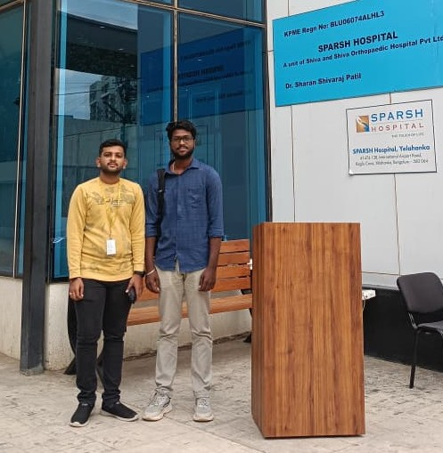
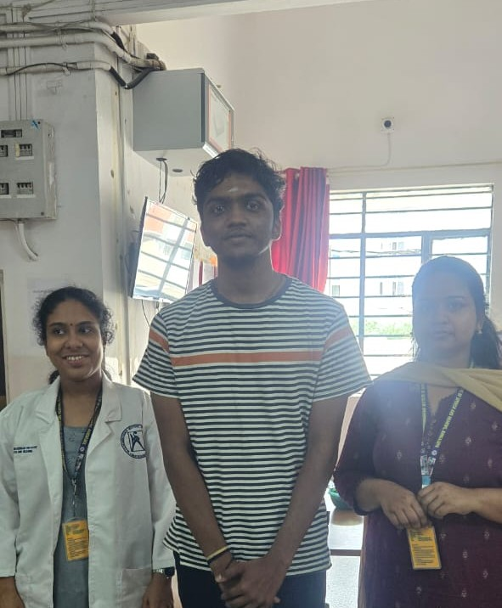
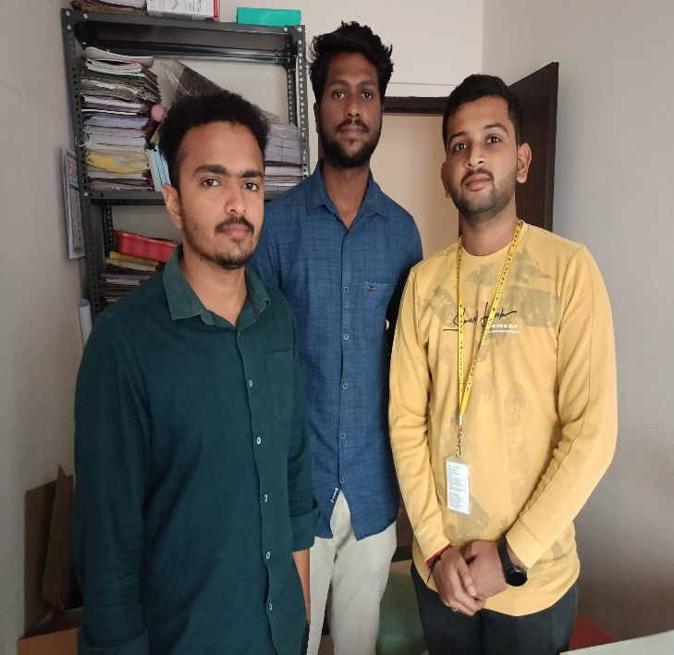
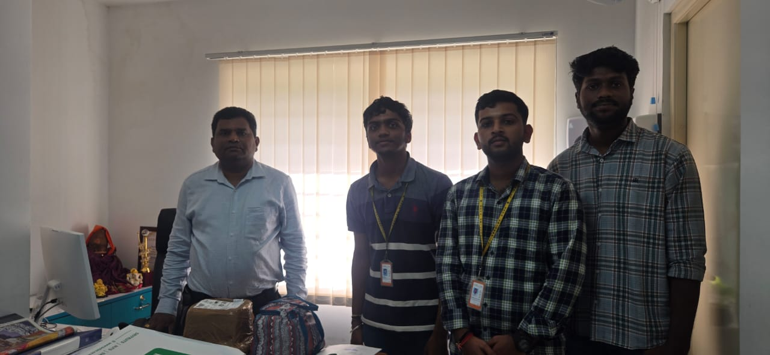
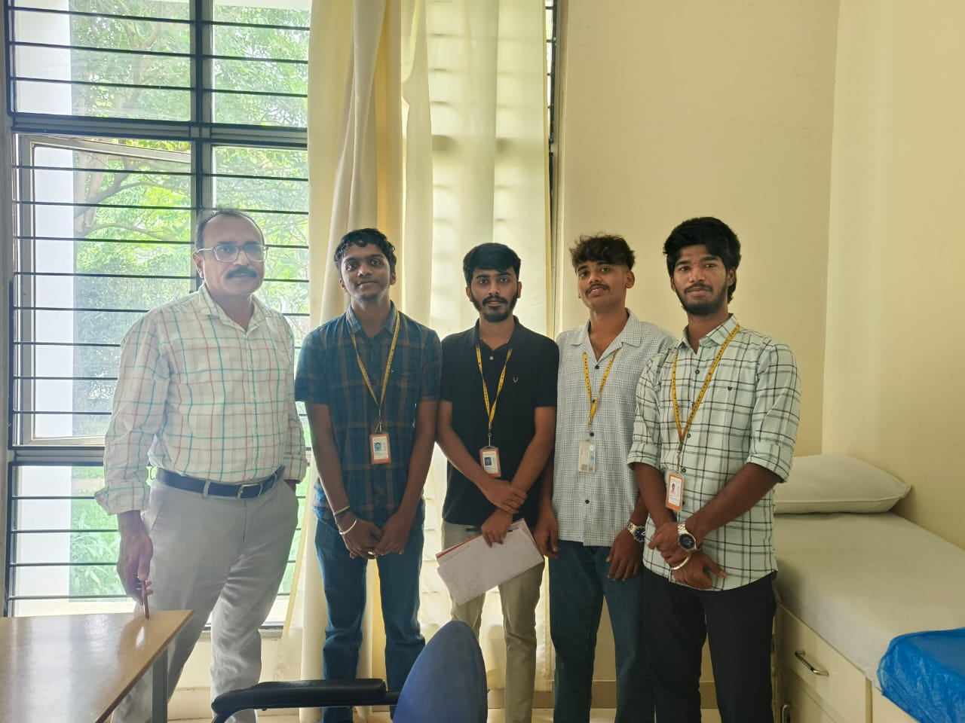
OUR CLIENT
Sparsh
DR.COSAH
Vallance
APEX
REVA

Slide 10
USER STORIES
1. The "CISO" / Chairman Story (Security)
PAIN: "I can't approve new AI tools that send patient data to the cloud. It's a security and privacy nightmare."
OUR SOLUTION: A 100% On-Premise "Fortress Model". All data and AI processing stay inside the hospital's firewall.
2. The "Skeptical Doctor" Story (Trust)
PAIN: "I don't trust a 'black box' AI. What if it's wrong? I need to verify its claims."
OUR SOLUTION: The "Glass Box" Verifiable Summary. Every single sentence links directly to the original source document.
3. The "Pilot Partner" Story (Validation)
PAIN: "We want to innovate, but we can't find partners who take data safety as seriously as we do."
OUR SOLUTION: Our Security-First Approach is our biggest advantage. This has already validated our strategy and opened the door for future pilot programs.

Slide 11
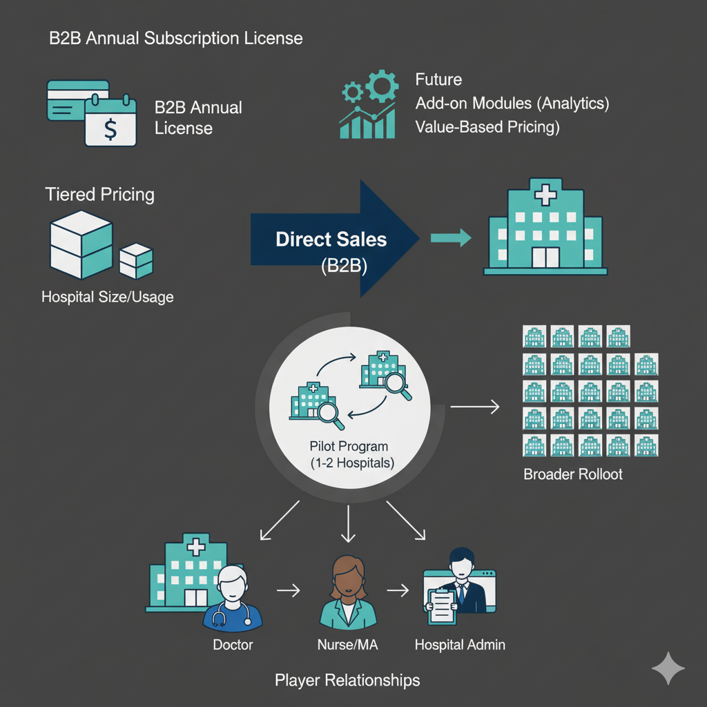
Business Model & Strategy
Revenue Model (Future Commercialization)
>Primary: B2B Annual Subscription License (per hospital/clinic) Tiered pricing (hospital size/usage).
>Future: Add-on modules (analytics), Value-Based Pricing (ROI).
>NOT: Pay-per-use, Freemium.
Business Model
>Channel: Direct Sales (B2B) to Hospital Leadership (CIOs, CMIOs).
>Strategy: Pilot Program (1-2 hospitals) for validation, case studies, and product refinement before broader rollout.
Player Relationships
>Hospital buys license; employees (MAs, Doctors) use software. Simple, direct.

Slide 12
Product Milestones
1.MVP (Minimal Viable Product)
Deliverable: Functional "Canned Demo" (100% local on laptop).
Key Features:
PDF extraction & secure storage (PostgreSQL/pgcrypto).
AI search (pgvector) & local LLM synthesis (Ollama/Llama 3).
"Glass Box" summary with clickable citations in a React UI.
Multi-Specialty Support: Oncology & Audiology modules active.
Advanced Visuals: Automated Tumor Graphing & Audiogram plotting.
Workflow Tools: Integrated Chatbot, Digital Rx Writer, and Doctor Annotations.
Performance: Parallel Processing (Chain of Prompts)
Goal: Prove technical feasibility & showcase core concept/unique features.
2.Final Product
Deliverable: Enhanced demo integrated with a test EMR (via FHIR adapter).
Key Features:
Pulls live (anonymized) patient data.
Refined multi-modal synthesis & MA workflow elements.
Goal: Show readiness for a real-world hospital pilot study.

Slide 13
Total Budget, Required Support and Regulation
Total Budget
>Current (MVP/SEE): ₹0 (Open-source, student effort, existing hardware).
>Future: Minor costs (₹<5,000) for API testing needed before pilot. Future commercialization requires significant investment (salaries, infrastructure, sales, compliance).
Required Support
>Now: Mentorship & Clinician Feedback.
>For Pilot: Pilot Partner Hospital (for infrastructure, EMR access, staff support).
>Guidance: Legal/Compliance expertise.
Regulation & Compliance
>Data Privacy: DPDPA / HIPAA compliant by design (on-premise data residency).
>Medical Device: Clinical Decision Support tool (not diagnostic). Clinician-controlled.

Slide 14

Thank You

